Slide 1
Attractions Map
-A WeChat Mini Program
By Jason Zhou (Juan Zhou)
https://github.com/JuanZhou23/attractionMap

Slide 2

Wechat?
WeChat is a mobile application developed by Tencent with about 1 billion active users
It currently provides the following functions:
Messaging
Audio/Video calling
Mobile payment
Social media feeds
And much more

Slide 3
Wechat Mini Program?
WeChat mini programs are web-based applications that can only be opened from WeChat, and are limited to 10MB per program
They have gained massive popularity due to the sheer amount of WeChat users
Frontend are based on JavaScript, WXSS , and WXML
Backend are based on Php, Java, or C#
It is/can:
Installation-free
Interact with various Tencent service
Such as mobile payment, map, personal profile, contact list
It isn’t/can’t:
Full fledged mobile application
Listed on app store (IOS, Android)
*wxss and wxml are WeChat specific languages that are very similar to CSS and HTML5

Slide 4
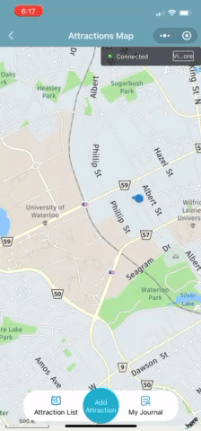
Attractions Map?
It is intended for users to mark down locations where they found incredible and share with other users.
It utilizes Tencent Map to pinpoint locations of each interesting attractions that users find.
All videos are recorded using Iphone running the mini program.

Slide 5
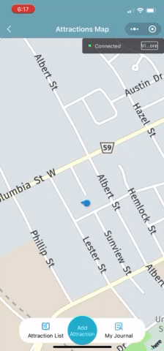
Function Showcase - Add Attraction Part 1
Tapping on the center button will add a new attraction.
This would prompt a request for the current user’s name, profile photo, region and gender.
After a success request, the user would be put into the add attraction page.
In this case this user has a cat photo as as profile photo, and 搜不到的周 as profile name.

Slide 6
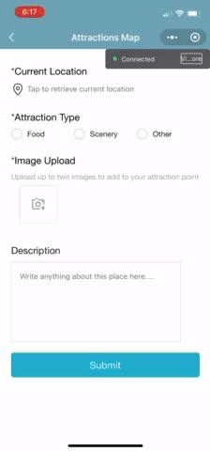
Add Attraction Part 2
By tapping on the location bar, the user would be prompted to select the attraction location on the map.

Slide 7
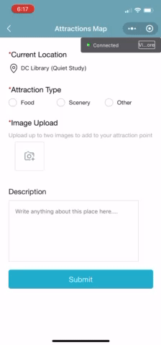
Add Attraction Part 3
Next, the user can select the most fitting attraction type.

Slide 8
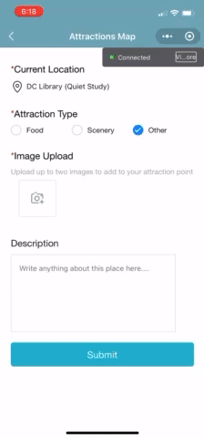
Add Attraction Part 4
The user then needs to add a photo to represent this location, up to a maximum of two.
Users have the option to take a photo on the spot, or select one from their album.
If the user made an mistake, they have the option to remove that image and re-upload photos.

Slide 9
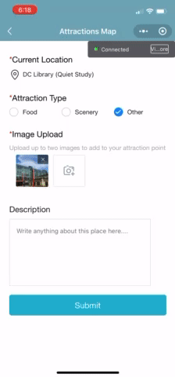
Add Attraction Part 5
Lastly, users can choose to add in their comment about this location.
After that, they will press Submit button to upload this location to the cloud server.

Slide 10
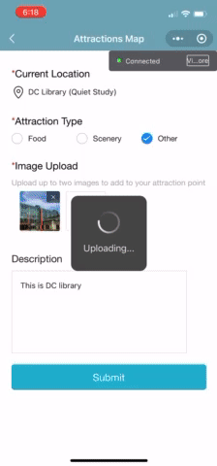
Function Showcase - Submit Success Page
After submitting, the user will be shown their profile photo and name.
This info will be accompanied by the amount of time that the user has submitted location markers.
A popular attraction photo will be shown.

Slide 11
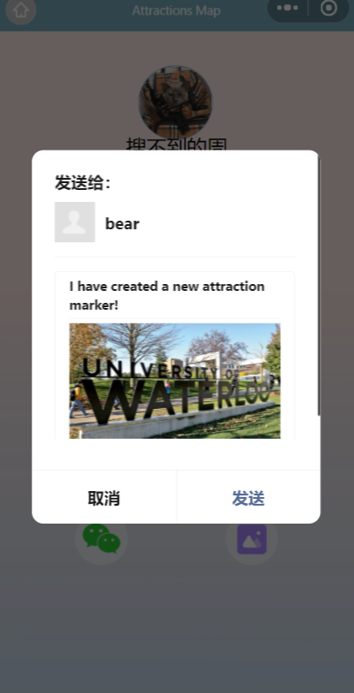
Submit Success Page Part 2
By pressing the WeChat logo on the bottom left, users will be prompted to share their new attraction with friends on WeChat.
Send to
Cancel
Send

Slide 12
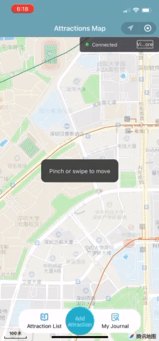
Function Showcase - My Journal
Users can click the left button “My Journal”, to see all locations that they themselves have recorded.
The attractions are sorted in most to least recent, alongside their location and photo.

Slide 13
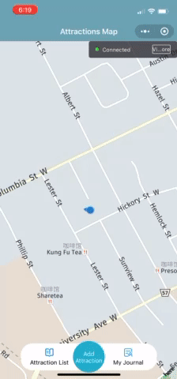
Function Showcase - Attraction List
The right button “Attraction List” will take the user to the full database where all attractions made by all users will be found here.
Each item is clickable and there is a search bar on the top.

Slide 14
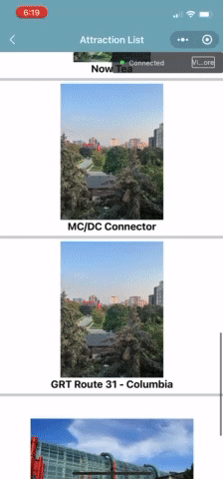
Attraction List Part 2
The user can click on each item to get a brief introduction about that location.
The “Take me there” button will give user the option to use either Tencent, Google, or Apple map to navigate from their current location to the location marker.

Slide 15
Q&A
Where does this program store all the photos, location, user info?
This program sends data directly to Tecent Cloud database, all infos are stored inside. There are no local save data, although users may download photos if they choose to. All users will share the same “Attraction List”.
Are there limitations to this method?
The main limitation is due to Tecent Cloud only allowing 500 requests per day to free personal users. During my testing period, it was easy to reach 200 requests just by myself. If this program wants to reach a wide audience, the database need to support a sufficient storage capacity in addition to the large amount of requests.

Slide 16
Thanks for your time~
And here is my github link
https://github.com/JuanZhou23/attractionMap

